Slide 1
Student Performance Analysis
Presented by:
Name:Julakanti Suvarchala

Slide 2
Objective of Student Performance Analysis:
It is mainly developed to know the complete analysis od all the students
It defines the average marks of all students
It also gives description about all students(pass/fail)
It takes the excel file as an input
It also asks for the pass marks and minimum attendence percentage
Based asked perspective(the student is passed only if he pass all the subjects individually and has minimum attendence percentage) it gives the result of the student

Slide 3
Technologies Used
Python
Pandas
Numpy
Conditions

Slide 4
Dataset Description
Student_id
Name
s1,s2,s3,s4,s5,s6 subject marks individually
Attendence
data set

Slide 5
Project Implementation
First the data is load using pandas.
Then takes input for pass marks, minimum attendence.
Then condition like is_pass to find the result of the students uses numpy.
Then finds for the Average marks of every student used pandas dataframe.
Then something write description about the student wheather passed or failed and how they are performing in each and every subject
Then gives name of the top student

Slide 6
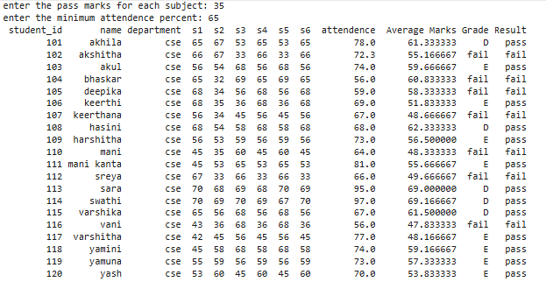
output:
If pass marks=35 and minimum attendence is 65

Slide 7
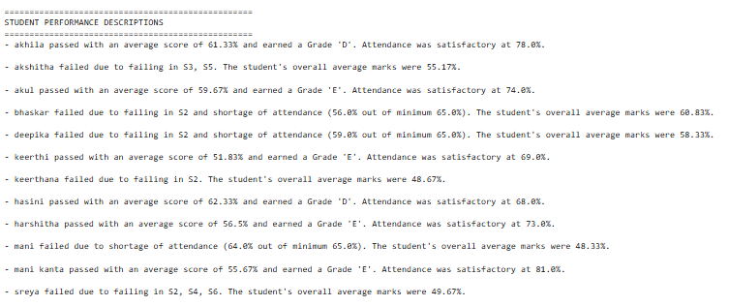

Slide 8
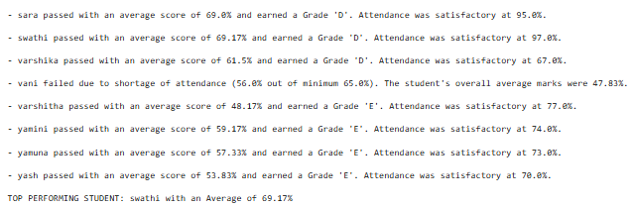

Slide 9


